Slide 1
Understanding Religion and Literature
Religion has always been an integral part of the literary tradition: many canonical and non-canonical texts engage extensively with religious ideas, and the development of English Literature as a professional discipline began with an explicit consideration of the relationship between religion and literature.
Literature also plays an important role in religious writing, as twentieth-century work on narrative theology has acknowledged. Both the recent theological turn of literary theory and the renewed political significance of religious debate in contemporary western culture have generated further interest in this interdisciplinary area.

Slide 2

Lesson Objectives:
To understand the place of religion and literature
To be able to identify allusions to religion in the GCSE texts that you have studied
To gain confidence in discussing key religious ideas within all texts studied.

Slide 3
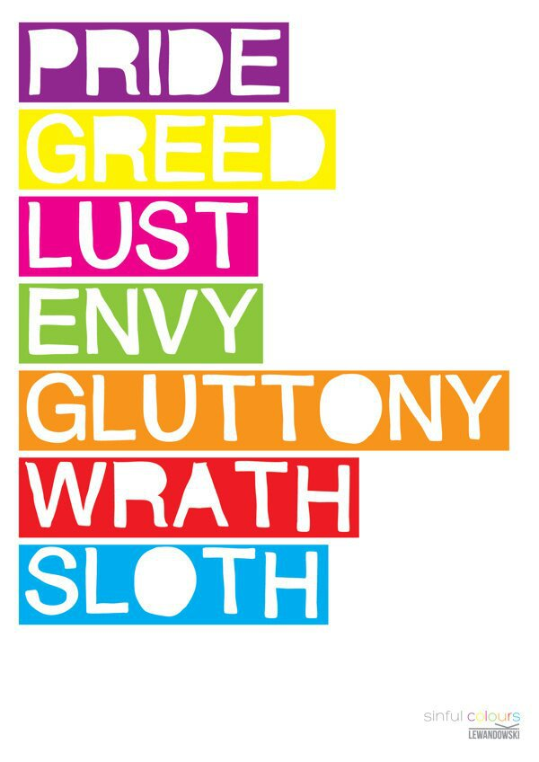
The Seven Deadly Sins

Slide 4
An Inspector Calls
The Strange Case of Dr Jekyll and Mr Hyde
In pairs, identify how the seven deadly sins are conveyed in the different texts
Macbeth
Use quotations to support your ideas
Explore connotations
Develop your inference skills

Slide 5

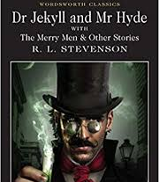
Developing our analysis through religious knowledge
Religious imagery within The Strange Case of Dr Jekyll and Mr Hyde

Slide 6
In your groups, read and identify key ideas from the handouts.
For ten minutes, as a group, you will write down the key facts on your table.
As a class, you will then have fifteen minutes to walk around and source the ideas.

Slide 7
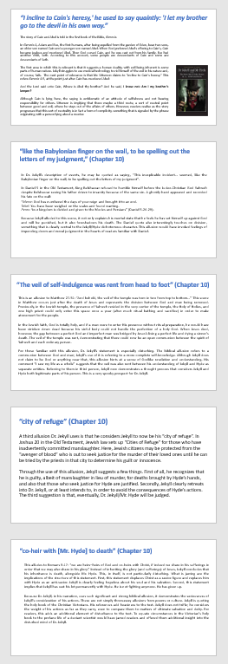
10 minutes
As a group, write down the key facts retrieved from your information sheet.
Ensure that your literacy and articulation is clear, so that it can be read by others and your ideas can clearly be understood.
End

Slide 8
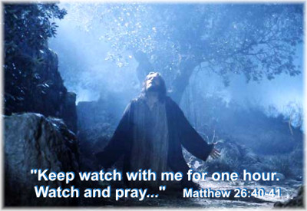
Hunt down your ideas, like Jesus was hunted down before his Crucifixion. Definitely do not fall asleep like his disciples! And he comes to the disciples, and finds them asleep, and said to Peter, What, could you not watch with me one hour?
15 minutes
E.g. As a class, you will then have fifteen minutes to walk around and source the ideas.
End

Slide 9
“fire and blood and anguish”
What text does this come from?
The Inspector prophesises a terrible future if the Birlings do not take responsibility for the actions and amend their ways.
How can this link to time theory?

Slide 10
The Worst is Yet to Come (Revelation 8:1-13)
Recognize and respond before God’s wrath is revealed (8:7- 13).
In 8:7, “The first sounded, and there came hail and fire, mixed with blood, and they were thrown to the earth; and a third of the earth was burned up, and a third of the trees were burned up, and all the green grass was burned up.” In the Old Testament, hailstorms are a common element in God’s judgment.
Why were these judgments “mixed with blood”?
“Blood” is a key word here. Blood is the symbol of vengeance. Blood and fire were often combined as symbols of judgment.
How can we relate this to An Inspector Calls?

Slide 11
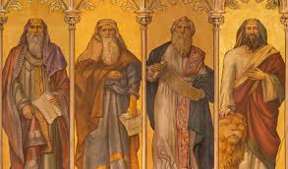
The Inspector is a spirit-like prophet who was able to manipulate the characters of the Birling family by revealing the chain of events and the hypocrisy behind the Birling family. He did not want to punish the family lawfully as he was more concerned with how immoral the upper class had become.
Inspector Goole also stated in his final didactic and sermon like speech that “if men will not learn that lesson, they will be taught it ‘in fire and blood and anguish’. This divine-like quote connotes that people will suffer the consequences if they do not accept that society should be entwined and that everyone should be responsible for each other. Priestley uses Inspector Goole as God’s messenger and a spirit who came to torment the consciousness of the living. Furthermore “anguish” can be interpreted as a reference to WW1 which shows that Inspector Goole is omniscient as the audience knows that WW1 had occurred shortly after the time in which the play was set.
Jeremiah: Prophet of Judgment and of Hope

Slide 12
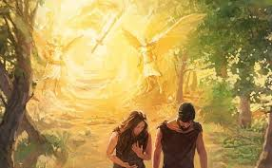
Biblical Reference:
Cast out of the Garden of Eden Genesis 3:22-24 –
"And the LORD God said, Behold, the man is become as one of us, to know good and evil: and now, lest he put forth his hand, and take also of the tree of life, and eat, and live for ever: Therefore the LORD God sent him forth from the garden of Eden, to till the ground from whence he was taken. So he drove out the man; and he placed at the east of the garden of Eden Cherubim, and a flaming sword which turned every way, to keep the way of the tree of life."
In the bible an angel with a flaming sword casts Adam and Eve out of the Garden of Eden for eating the forbidden fruit stopping them from visiting the tree of life.
How can we relate this to ‘fire and blood and anguish’?

Slide 13
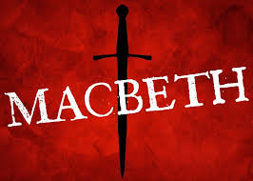
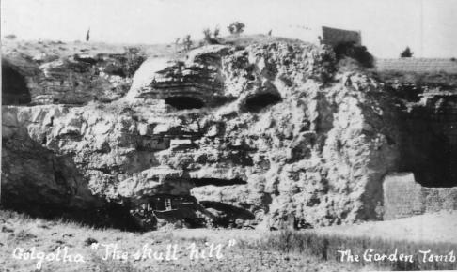
What text makes reference to Golgotha?
‘or memorise another Golgotha’

Slide 14
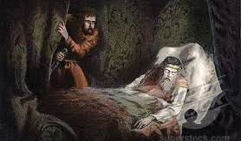
The Killing of King Duncan
The killing of Duncan by Macbeth, a man of great honor and dignity, is a biblical allusion to the killing of Jesus

Slide 15

The Trinity
The three witches represent the trinity of the father, son and holy spirit.
The three witches prophesize who Macbeth will become, much like prophets in the Bible prophesise about Jesus.
“Thou hast it now: king, Cawdor, Glamis, all, as the weird women promised…” Banquo: Act 3, Scene 1.

Slide 16
More Prophecy References
The weird sisters told Banquo that, “Thou shalt get kings, though thou be none.” Third Witch: Act 1, Scene 3.
“And I will make of you a great nation, and I will bless you and make your name great, so that you will be a blessing.” Genesis 12:2

Slide 17
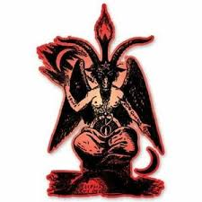
Macbeth as Lucifer
In the Bible, Satan was an angel, then ‘fell’ and became the devil. Macbeth was the same in that he was good and followed his king then he killed him to gain power.

Slide 18
Lady Macbeth as Pilate
After King Duncan is murdered, Lady Macbeth tells her husband “A little water clears us of this deed: How easy is it then!” Act 2, Scene 3.
After allowing the crucifixion of Jesus, Pilate “took water and washed his hands before the crowd, saying, ‘I am innocent of this man’s blood; see to it yourselves” (Matthew 27:24).

Slide 19

Reference to Judas Iscariot
“Who’s there, i’ th’ name of Beelzebub? Here’s a farmer, that hanged himself on th’ expectation of plenty.” Porter: Act 2, Scene 3.
Matthew 27:5 – “And throwing down the pieces of silver into the temple, he departed, and he went and hanged himself.”

Slide 20
Reference to Nile River
“ No; this my hand will rather the multitudinous seas incarnadine, making the green one red.” Macbeth: Act 2, Scene 2.
Exodus 7:20 – “… he lifted up his staff and struck the water in the Nile, and all the water in the Nile turned into blood.”

Slide 21
Lesson Objectives:
To understand the place of religion and literature
To be able to identify allusions to religion in the GCSE texts that you have studied
To gain confidence in discussing key religious ideas within all texts studied.

Slide 22
The following slides are to be printed on A3

Slide 23
“I incline to Cain's heresy,' he used to say quaintly: 'I let my brother go to the devil in his own way.”
The story of Cain and Abel is told in the first book of the Bible, Genesis.
In Genesis 4, Adam and Eve, the first humans, after being expelled from the garden of Eden, bear two sons, an older son named Cain and a younger son named Abel. When God preferred Abel's offering to Cain's, Cain became jealous and murdered Abel. Then God cursed Cain, and he was cast out from his family. Eve had another child, Seth. According to this account, some people are descendants of Cain and some are descendants of Seth.
The first area in which this is relevant is that it suggests a human duality, with evil being inherent is some parts of human nature. Jekyll struggles to use medical technology to rid himself of the evil in his nature and, of course, fails. The next point of relevance is that Mr. Utterson claims to "incline to Cain's heresy." This refers Genesis 4:9, at the point just after Cain has murdered Abel:
And the Lord said unto Cain, Where is Abel thy brother? And he said, I know not: Am I my brother's keeper?
Although Cain is lying here, the saying is emblematic of an attitude of selfishness and not bearing responsibility for others. Utterson is implying that there maybe a third route, a sort of neutral point between good and evil, where he stays out of the affairs of others. However, readers realise as the story progresses that this sort of neutrality is in fact a form of complicity, something that is signaled by the phrase originating with a person lying about a murder.

Slide 24
“like the Babylonian finger on the wall, to be spelling out the letters of my judgment,” (Chapter 10)
In Dr. Jekyll’s description of events, he may be quoted as saying, “This inexplicable incident… seemed, like the Babylonian finger on the wall, to be spelling out the letters of my judgment”.
In Daniel 5 in the Old Testament, King Belshazzar refused to humble himself before the Judeo-Christian God Yahweh despite Belshazzar seeing his father driven to insanity because of the same sin. A ghostly hand appeared and recorded his fate on the wall:
“Mene: God has numbered the days of your reign and brought it to an end.
Tekel: You have been weighed on the scales and found wanting.
Peres: Your kingdom is divided and given to the Medes and Persians” (Daniel 5.26-28).
Because Jekyll alluded to this scene, it not only explains his mental state that he feels he has set himself up against God and will be punished, but it also foreshadows his death. The Daniel quote also interestingly touches on division, something that is clearly central to the Jekyll/Hyde dichotomous character. This allusion would have invoked feelings of impending doom and moral judgment in the hearts of readers familiar with Daniel.

Slide 25
“The veil of self-indulgence was rent from head to foot” (Chapter 10)
This is an allusion to Matthew 27.51: “And behold, the veil of the temple was torn in two from top to bottom…” This scene in Matthew occurs just after the death of Jesus and represents the division between God and man being removed. Previously, in the Jewish temple, the presence of Yahweh resided in the very center of the temple, the Holy of Holies, and one high priest could only enter this space once a year (after much ritual bathing and sacrifice) in order to make atonement for the people.
In the Jewish faith, God is totally holy, and if a man were to enter His presence without ritual preparation, he would have been stricken down dead because his sinful body could not handle the perfection of a holy God. When Jesus died, however, the gap between a perfect God and imperfect man was bridged by Jesus’s living a perfect life and dying a sinner’s death. The veil of the temple was rent, demonstrating that there could now be an open communion between the spirit of Yahweh and each ordinary person.
For those familiar with this allusion, Dr. Jekyll’s statement is especially disturbing. The biblical allusion refers to a communion between God and man; Jekyll’s use of it is referring to a more complete self-knowledge. Although Jekyll does not claim to be God or anything near that, this allusion hints at a sense of Godlike revelation and understanding. His comment “I saw my life as a whole” suggests that the veil was also rent between his understanding of Jekyll and Hyde as separate entities. Referring to them in third person, Jekyll now demonstrates a thought process that considers Jekyll and Hyde both legitimate parts of his person. This is a very spooky prospect for Dr. Jekyll.

Slide 26
“city of refuge” (Chapter 10)
A third allusion Dr. Jekyll uses is that he considers Jekyll to now be his “city of refuge”. In Joshua 20 in the Old Testament, Jewish law sets up “Cities of Refuge” for those who have inadvertently committed manslaughter. Here, Jewish citizens may be protected from the “avenger of blood” who is out to seek justice for the murder of their loved ones until he can be tried by the priests in that city to determine his guilt or innocence.
Through the use of this allusion, Jekyll suggests a few things. First of all, he recognizes that he is guilty, albeit of manslaughter in lieu of murder, for deaths brought by Hyde’s hands, and also that those who seek justice for Hyde are justified. Secondly, Jekyll clearly retreats into Dr. Jekyll, or at least intends to, in order to avoid the consequences of Hyde’s actions. The third suggestion is that, eventually, Dr. Jekyll/Mr. Hyde will be judged.

Slide 27
“co-heir with [Mr. Hyde] to death” (Chapter 10)
This alludes to Romans 8.17: “we are heirs–heirs of God and co-heirs with Christ, if indeed we share in his sufferings in order that we may also share in his glory.” Instead of inheriting the glory (and sufferings) of Jesus, Jekyll concludes that his inheritance is death, alongside Mr. Hyde. This, in itself, is not particularly disturbing. What is jarring are the implications of the structure of this statement. First, this statement displaces Christ as a savior-figure and replaces him with Hyde as an anti-savior. Jekyll is clearly feeling hopeless about his soul and his salvation. Second, this statement implies that Jekyll has cast his lot permanently with Hyde. He is not fighting anymore. He has given up.
Because Dr. Jekyll, in his narration, uses such significant and strong biblical allusion, it demonstrates the seriousness of Jekyll’s consideration of his actions. These are not simply throwaway allusions from poems or culture. Jekyll is quoting the holy book of the Christian Victorians. His references add heaviness to the text. Jekyll does not trifle; he considers the weight of his actions as far as they carry, even to compare them to matters of ultimate salvation and deity. For readers, this adds an additional element of disturbance to the text. To equate circumstances in the Victorian’s holy book to the profane life of a deviant scientist would have jarred readers and offered them additional insight into the disturbed mind of Dr. Jekyll.

